Slide 1
How (and why) to use GitHub for your research
Learn Bioinformatics Chat
April 2022
Slides are currently available on our GitHub!
https://github.com/learn-bioinformatics/why_use_github

Slide 2
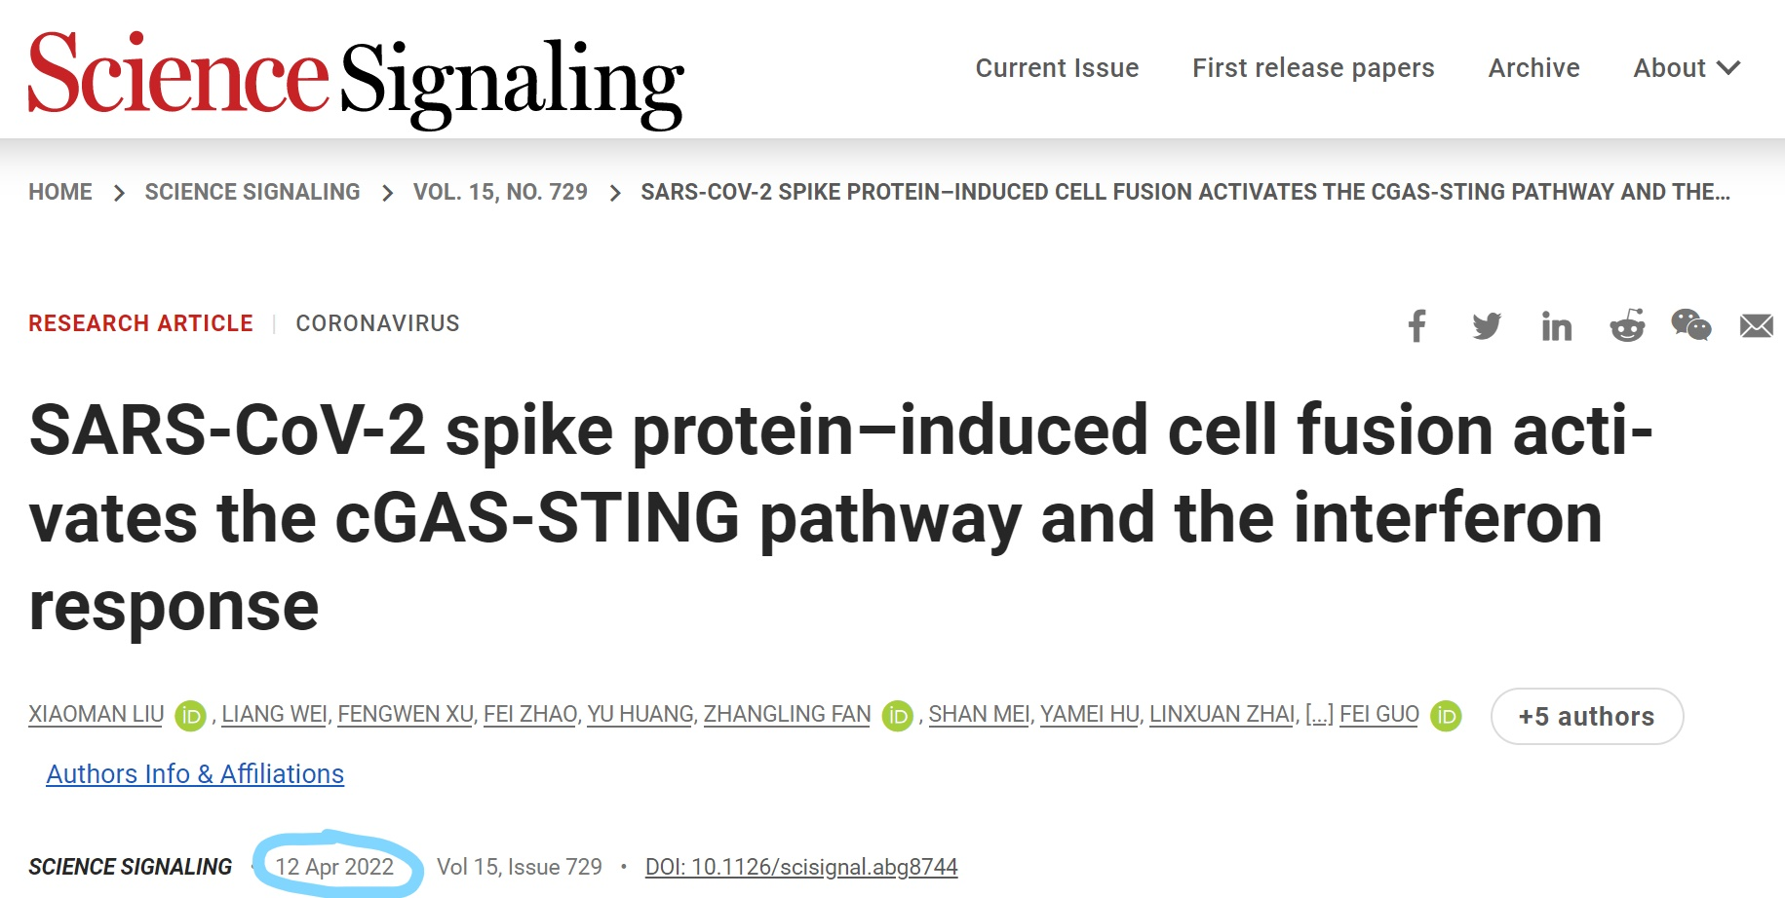

Slide 3
This is a big problem for usability and reproducibility.
“ RNA-seq data analysis
Raw sequencing reads were curated as previously described (25). Briefly, the FASTQ files were subjected to adapter trimming to remove the low-quality reads and short reads. All clean data were mapped to the human genome GRCh38 using HISAT2 v2.1.0 with default parameters. Bam files were sorted by Samtools 1.9. Gene counts were summarized using the feature Counts program as part of the Subread package release 2.0.0
“
There is no code associated with this paper.

Slide 4
Usability
Reproducibility
Can your own lab currently use and build upon the code if the code writer leaves?
Can your lab reproduce the analysis and rebuild all figures from raw data if the code writer leaves?
Local
Can anyone download, use, and build upon your code?
Can anyone find your raw data and code, and reproduce your analysis and figures?
Global
All four problems can be solved by using GitHub.

Slide 5


What is GitHub?

Slide 6
Git is a version control software that lets you save checkpoints of your work. Git runs locally. GitHub is an online home for your Git projects.

Slide 7
Core Features of using Git + GitHub
Version
Control
Code
Organization
Collaboration
Reproducibility

Slide 8
Features of Git + GitHub
Version
Control
Maintains old versions of code – shows you specifically what changed between each version.
Collaboration
GitHub makes it easy for lab members to work together, or for external collaborators to work with you. Can control private or public access with ease.
Code
Organization
Each change is documented so you don’t need to save duplicate versions of files over and over. Publishing code causes you to think about how your code is presented and encourages you to write documentation.
Reproducibility
Your repositories can be easily shared and enable your research code to be reproducible, for future use in your own lab, or for other people across the world using your research.

Slide 9
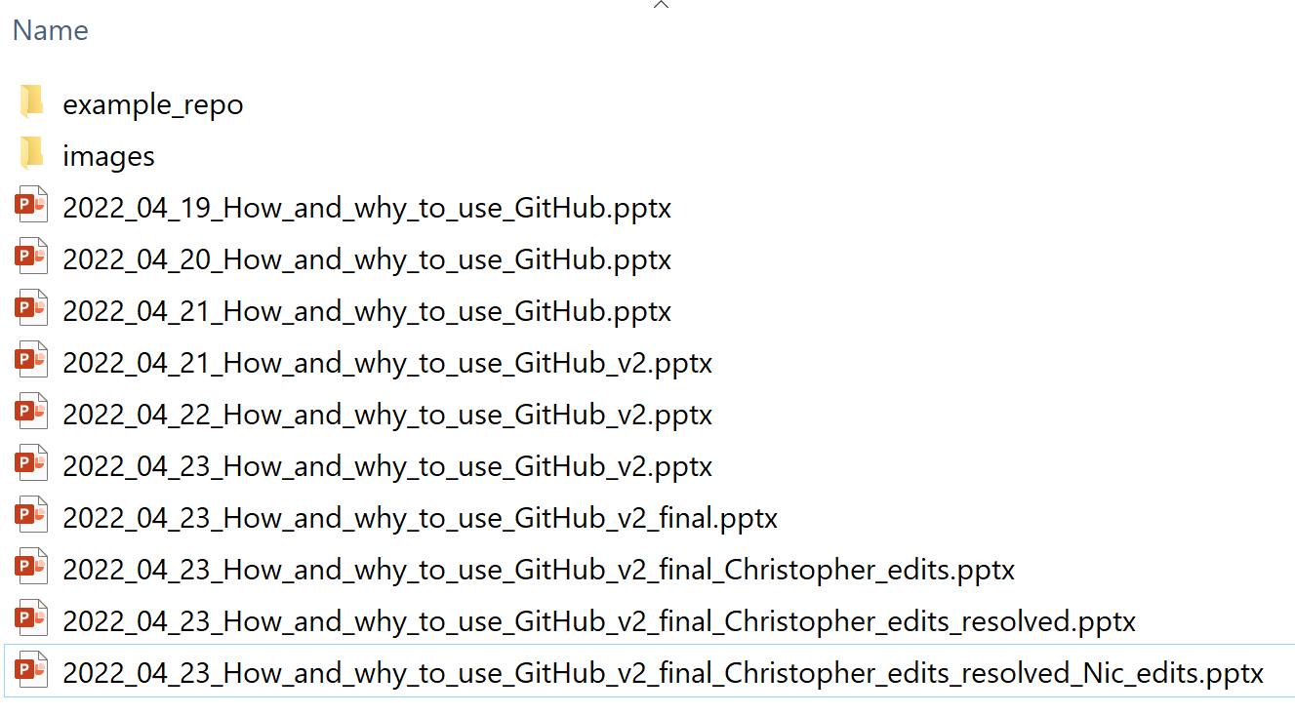
Do your files look like this?
If so, you need git (version control).

Slide 10
One caveat, GitHub is not a place to store large datasets
It is not meant to be used for storing large datasets. GitHub is for code and analysis scripts or small files.
For local, secure data storage, use the OMRF Data Server, Dropbox, or the o3 Archive (contact Stuart Glenn for help moving data to o3).
For sharing datasets for publication, you will need to upload and store within one of the public repositories, such as the Sequence Read Archive (SRA), the Gene Expression Omnibus (GEO), the Imaging Data Commons, etc. See a list of all the NIH-affiliated Data Repositories here:
https://sharing.nih.gov/data-management-and-sharing-policy/sharing-scientific-data/repositories-for-sharing-scientific-data

Slide 11
Why use GitHub?

Slide 12
The biggest reason to use GitHub for research?
You code is easy to share for publication.
This increases your research impact.

Slide 13
The second biggest reason to use GitHub for research?
The NIH is updating their data sharing guidelines on Jan 25 2023, and you need to specify how you plan on sharing your data and your analysis / code.
Using GitHub increase the likelihood of getting NIH-funding.

Slide 14
How to use GitHub? Part 1 – Setup

Slide 15
We will cover:
A
Setup
B
How to use Git
1
Create GitHub Account
1
Git config
2
Create Remote Repo on GitHub
2
Clone remote repo to local
3
Install Git locally (if necessary)
3
Add files to version control
4
SSH Key Setup
4
Using Git!

Slide 16
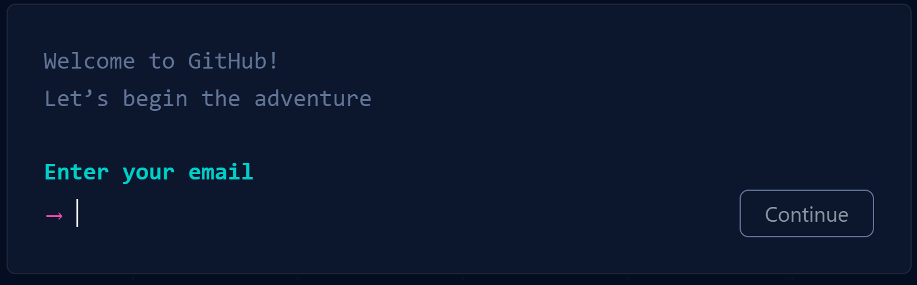
1
Create GitHub Account
Simply go to: github.com
and click Sign Up

Slide 17
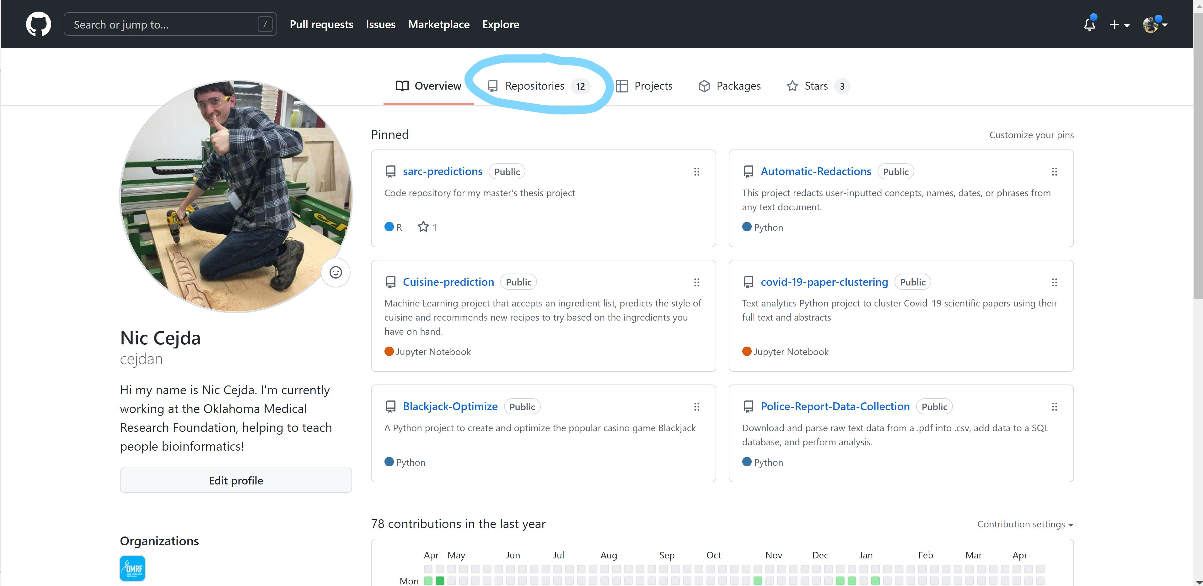
2
Create Remote Repo on GitHub

Slide 18
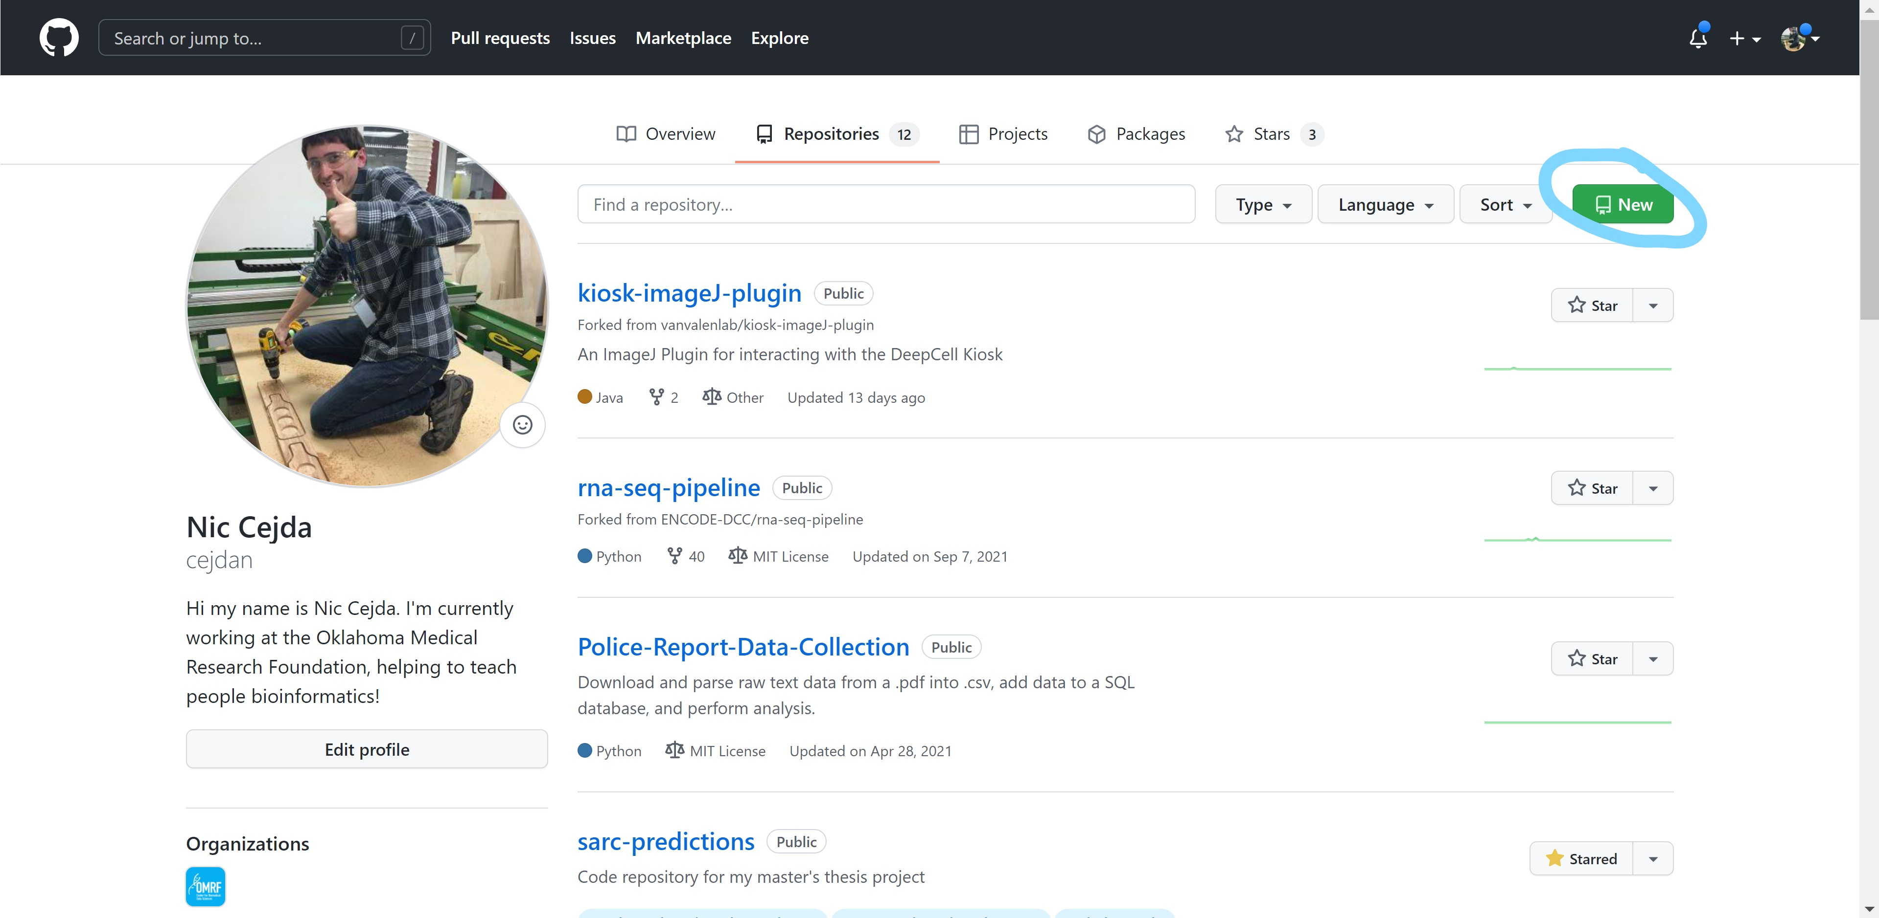
2
Create Remote Repo on GitHub

Slide 19
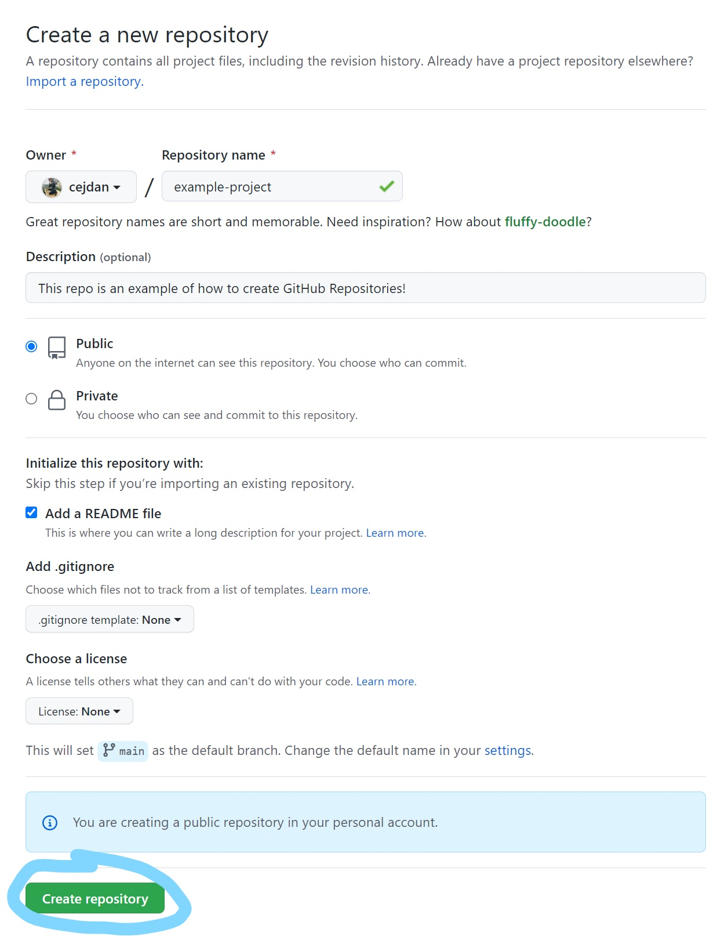
2
Create Remote Repo on GitHub
Can choose Public or Private depending on need

Slide 20
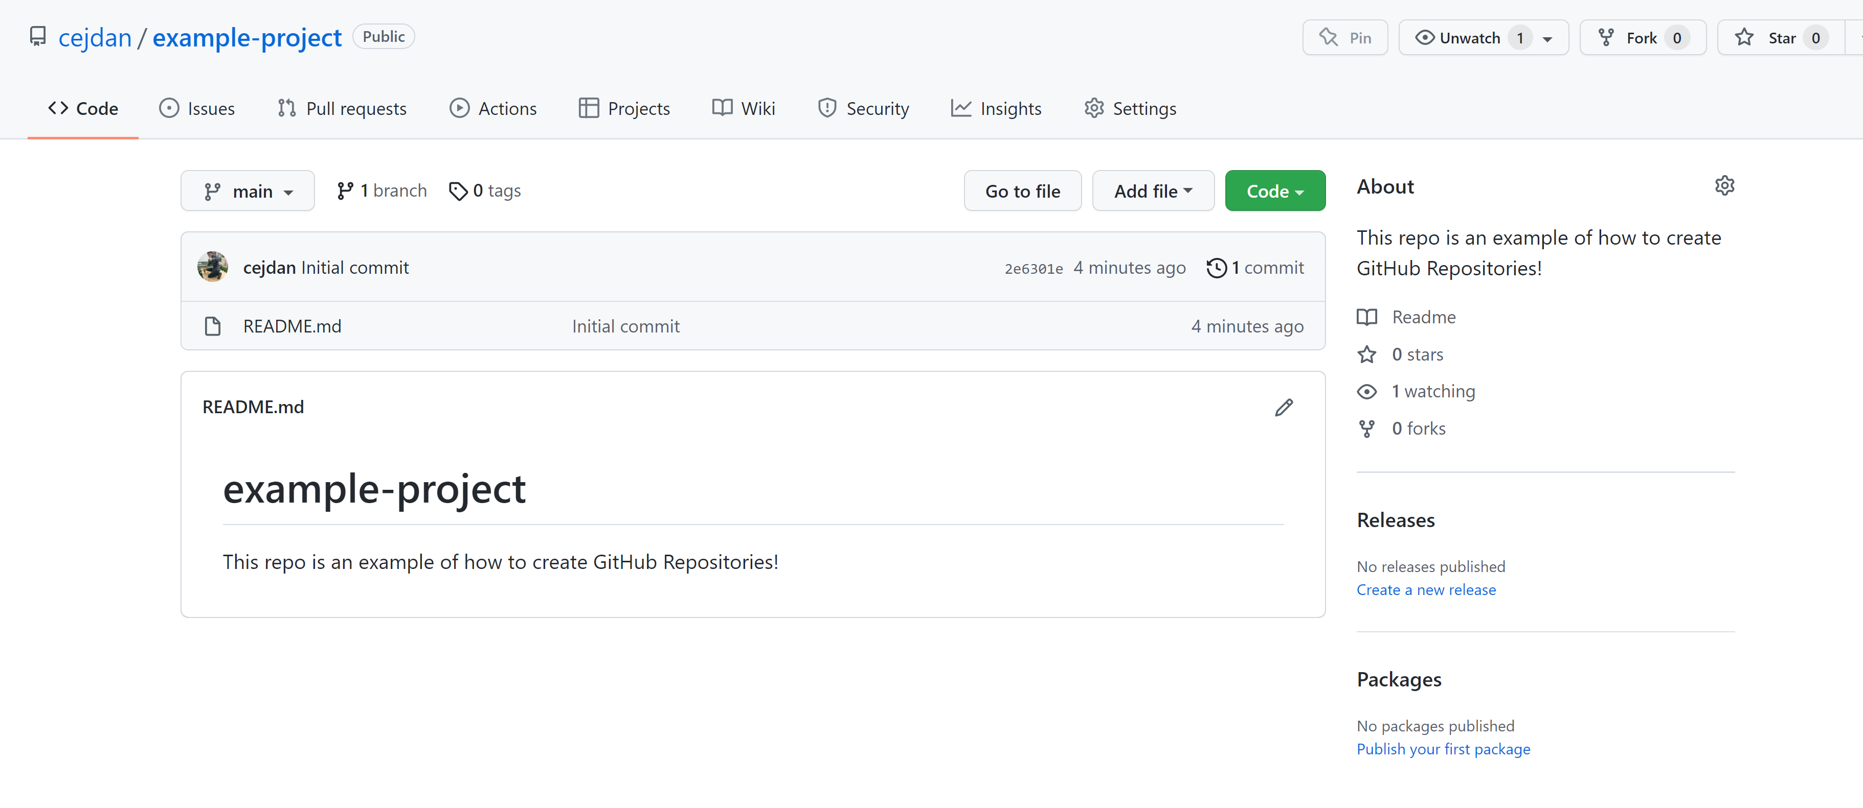
2
Create Remote Repo on GitHub

Slide 21
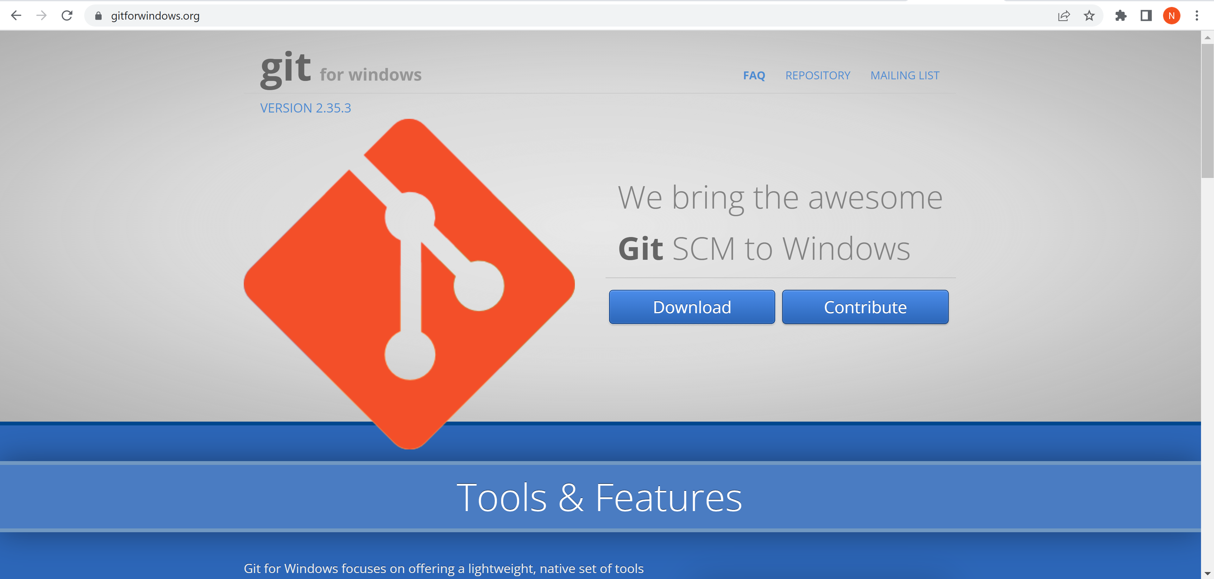
3
Install Git Locally (if necessary)
Windows users, navigate to https://gitforwindows.org/
Download and follow the default install instructions.
Git comes pre-installed on Mac and on our Linux compute cluster!

Slide 22
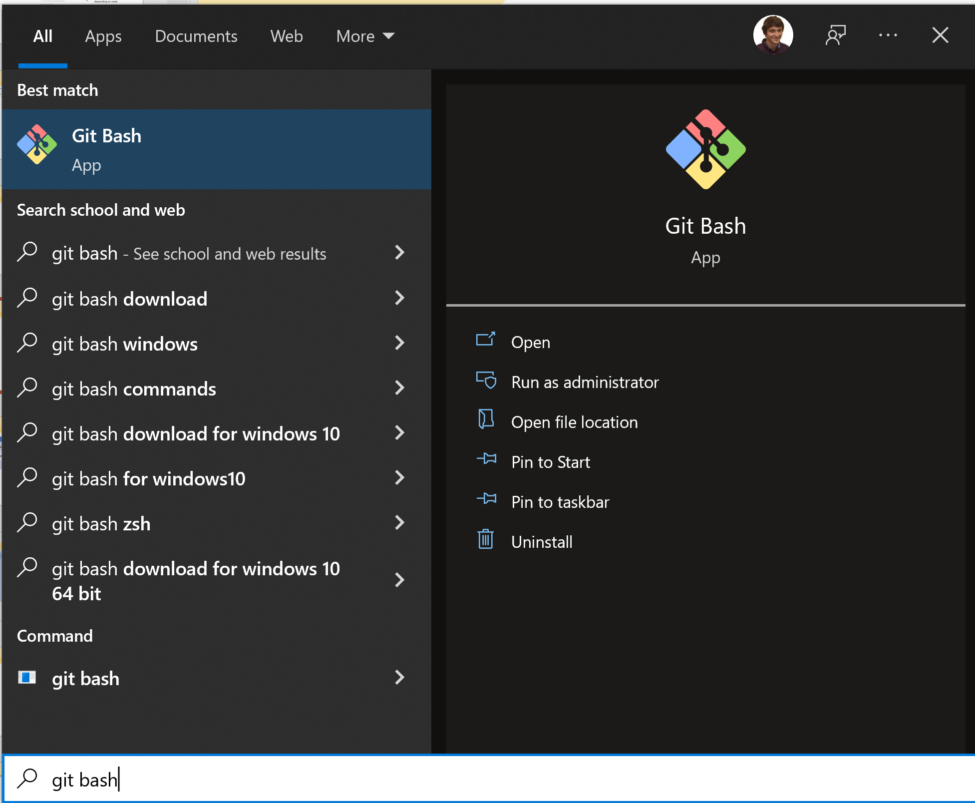
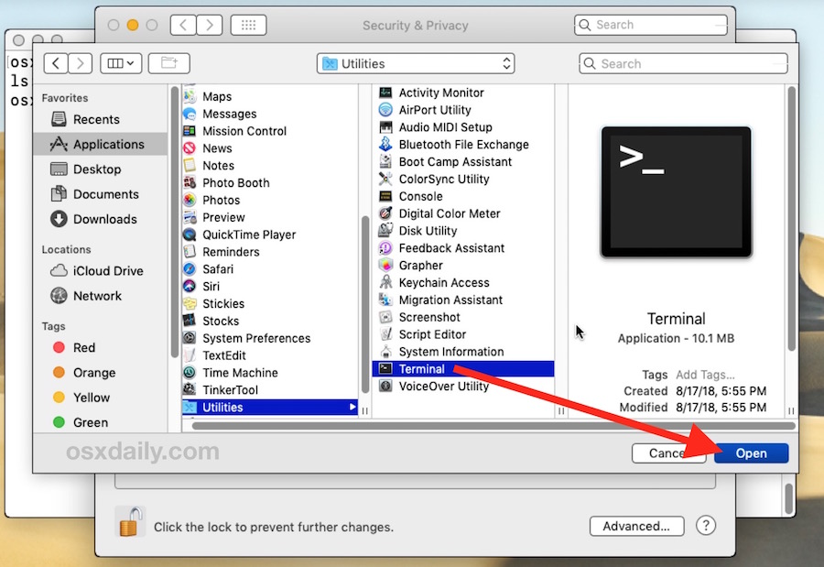
4
SSH keys setup
Let’s open Git and get set up!
Windows
Mac

Slide 23
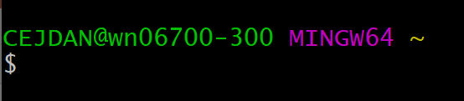
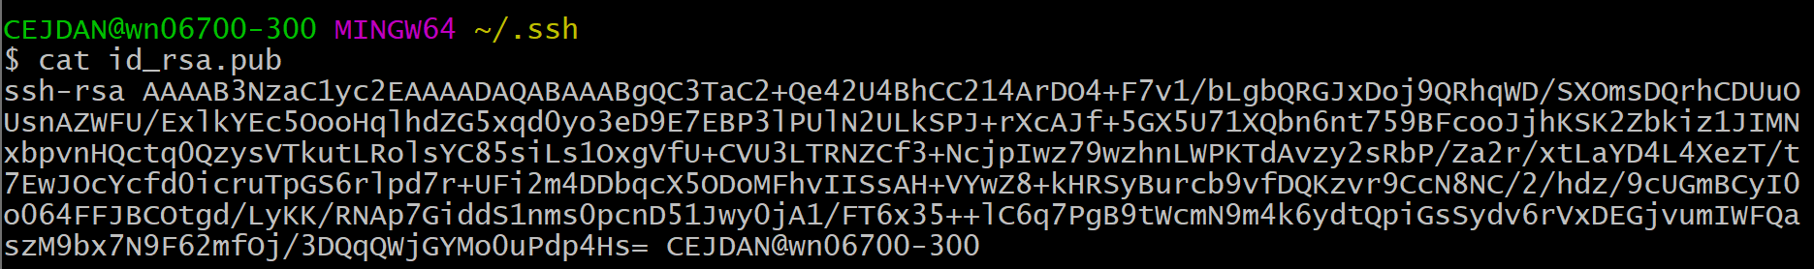
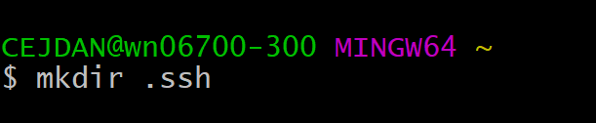

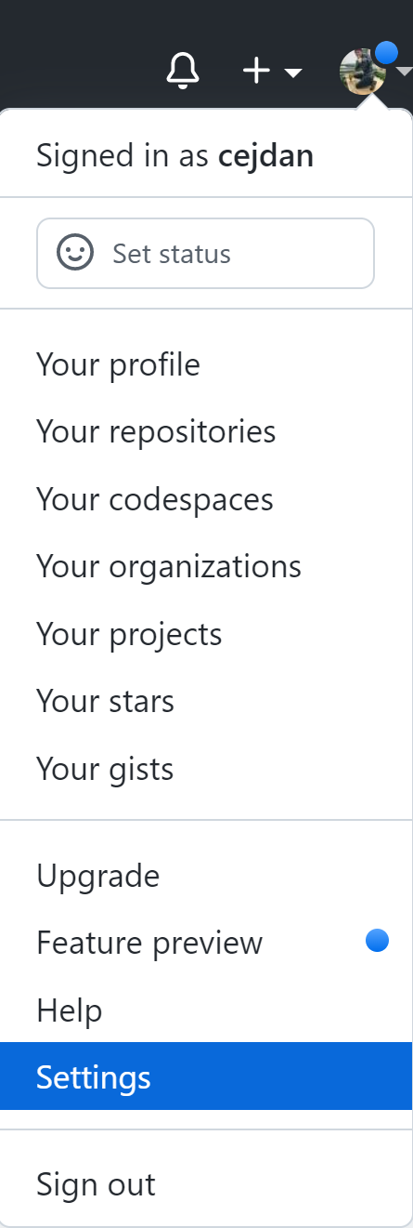
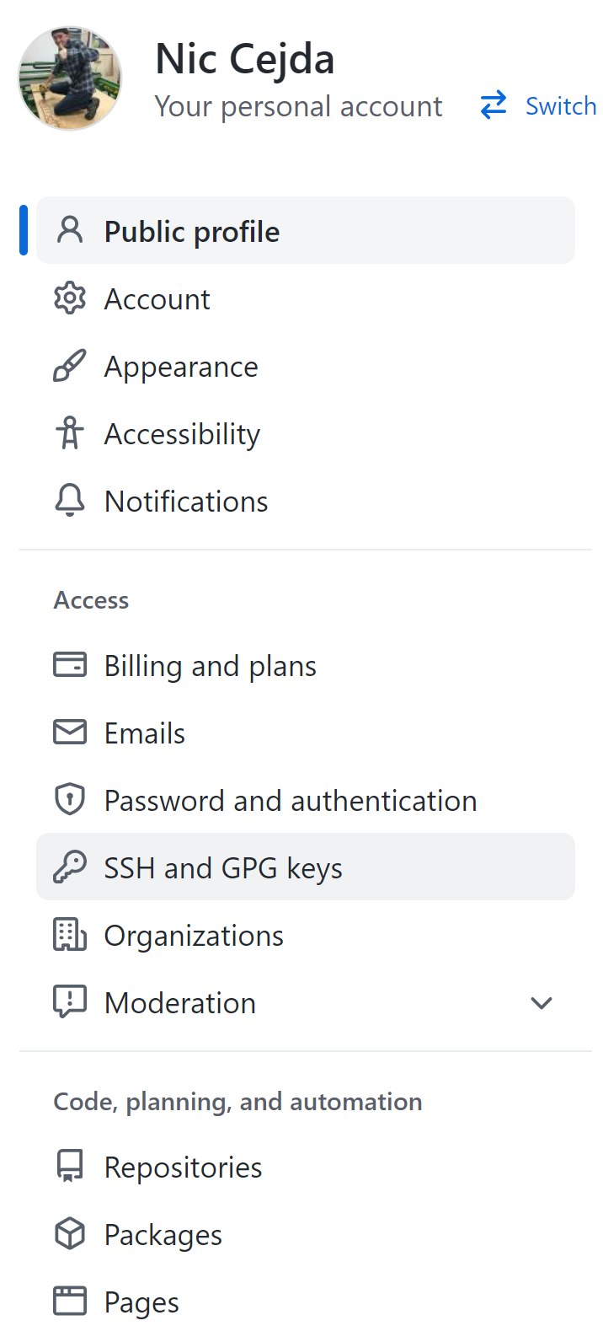
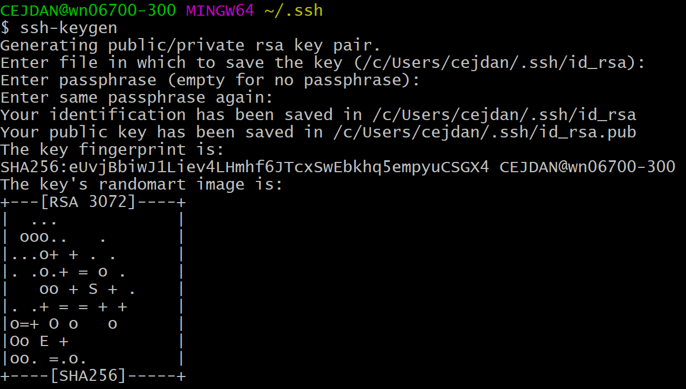
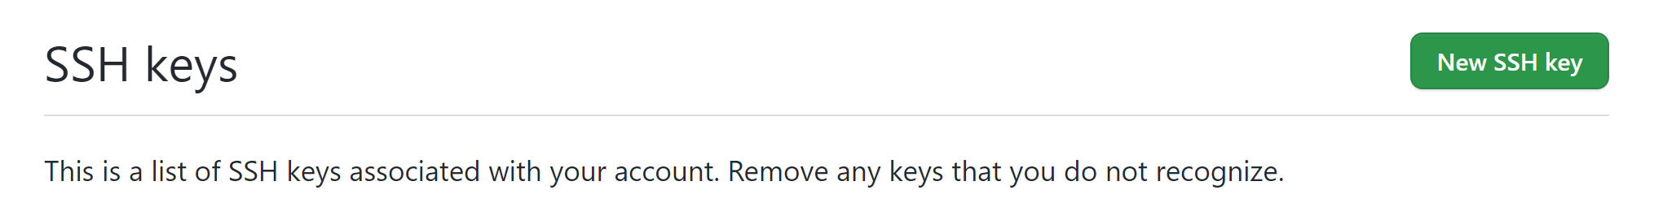
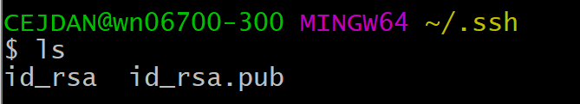
4
SSH keys setup
1)
7)
2)
3)
4)
8)
9)
10)
5)
6)

Slide 24
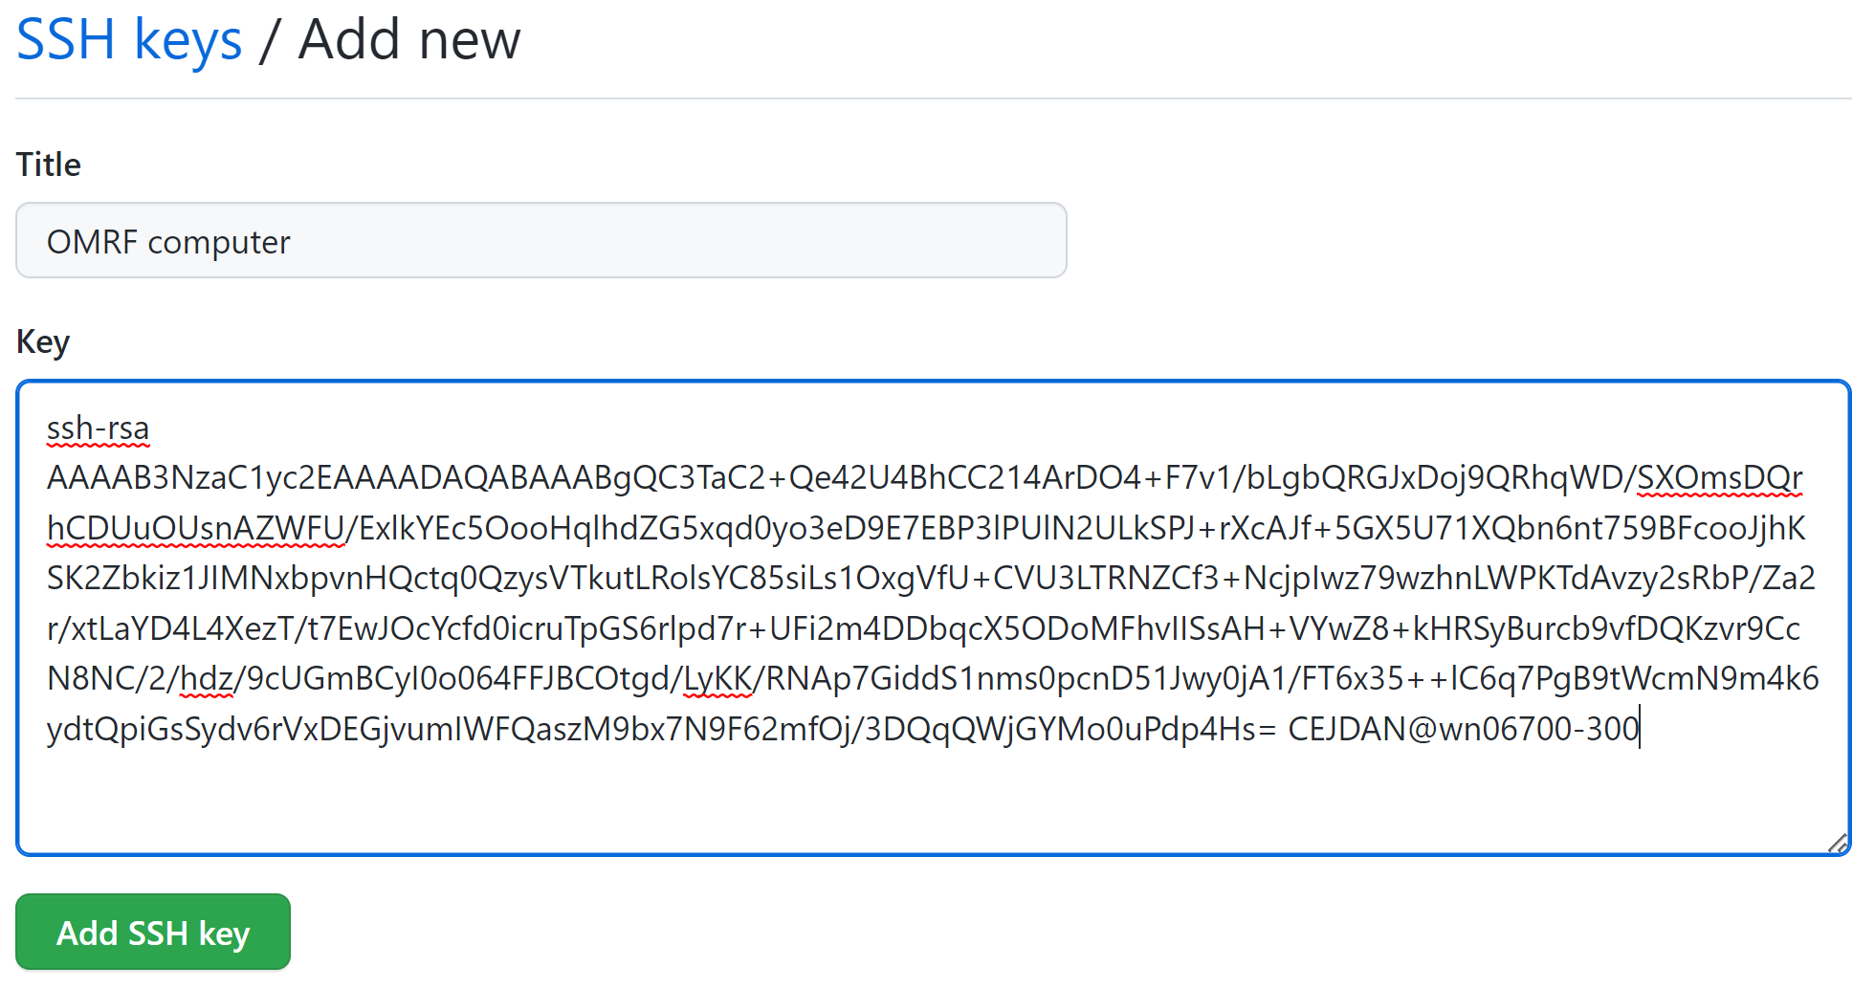
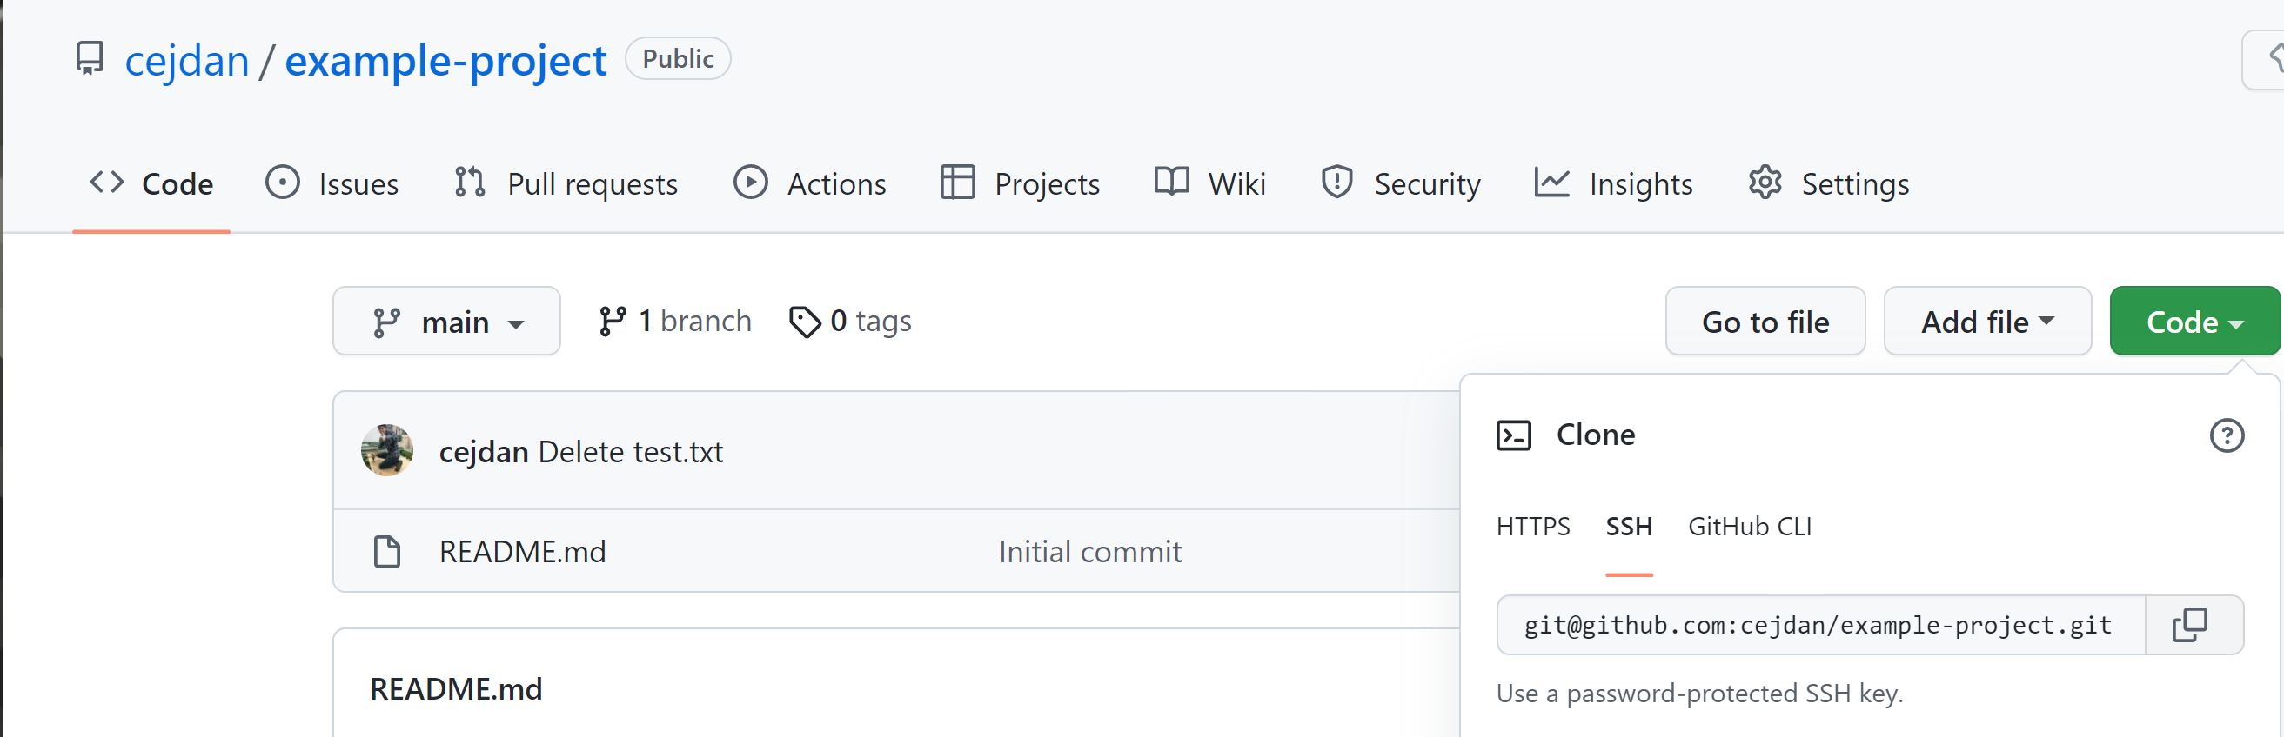
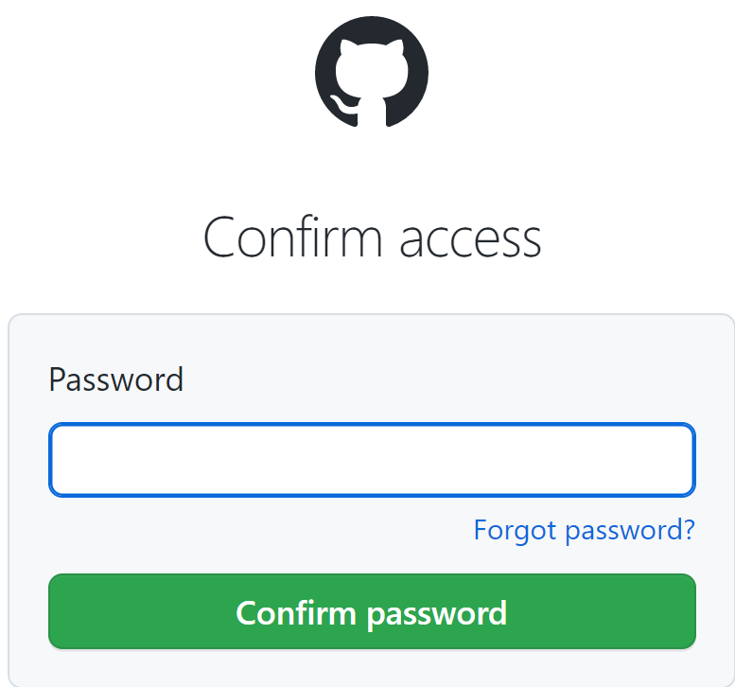
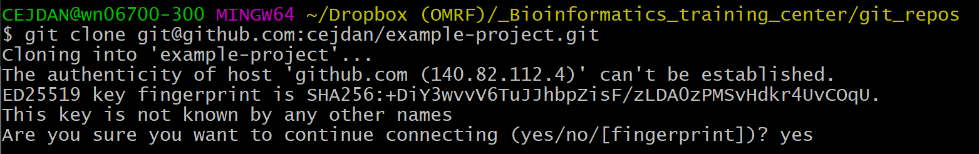

4
SSH keys setup
11)
13)
14)
12)
15)

Slide 25
How to use GitHub? Part 2 – Basic usage

Slide 26
First, run some set-up commands.
1
Git config
Command | Description
git config –-global user.name “your_github_username” | Sets up your username so GitHub will recognize you.
git config –-global user.email “your_github_email@example.com” | Sets up your email so GitHub will recognize you.
git config –-global --list | Shows your current config setup information.

Slide 27


2
Clone remote repo to local

Slide 28
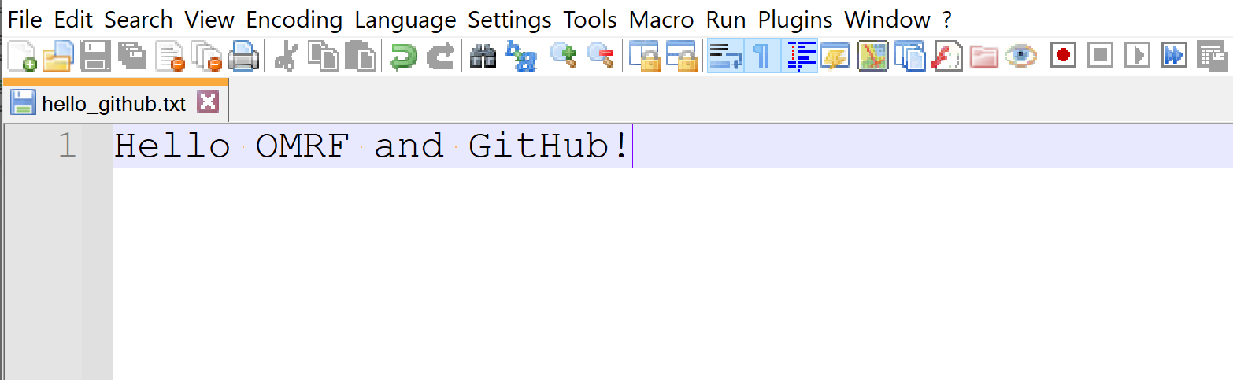
3
Create files to version control
Can upload any file:
< 100Mb if uploading from the command line, or
< 25Mb if uploading on the web interface.
Total Repository size limits:
< 1Gb Recommended
< 5Gb Strongly Recommended
Example file we want to version control on GitHub:

Slide 29
Quick Detour – How Git Works

Slide 30
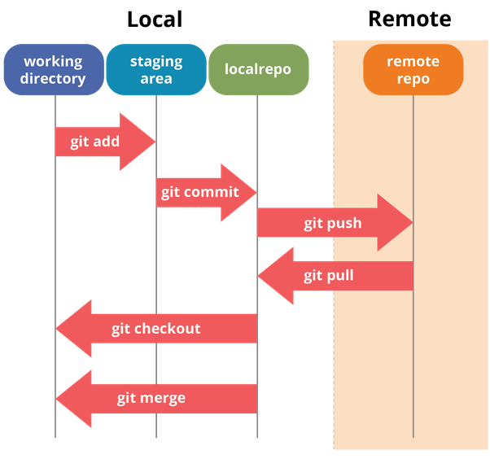
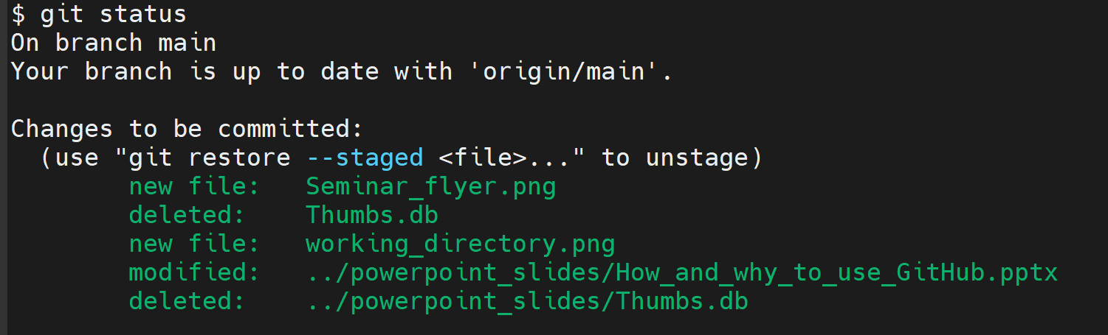
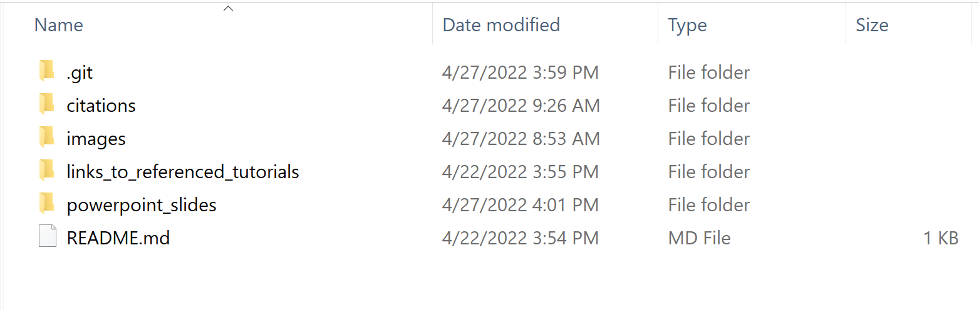
Local
Remote

Slide 31
git add
git commit
git push
git pull
git merge
git clone
git clone

Slide 32
4
Using Git! The essential commands
Command
Description
Clones an existing repository from the web onto your local
git clone https://...
machine.
git add filename(s)
Adds a file to your git
stage
, won’t commit yet!
Shows all the files that have been changed and displays which
git status
files have been added to the
stage
.
git restore
–
-
Removes a file from the stage.
staged filename(s)
Removes a previously committed file from the repository.
git rm filenames(s)
Won’t commit the deletion yet!
Creates a version control checkpoint. This is the most
git commit
–
m “description”
important operation! Does not push changes to the web yet,
only commits locally.
Pushes committed changes to the web. This might involve
git push
merging if your local version and the web version modified the
same file.
Updates your repository with the latest commit from the web.
git pull
Might involve merging if the web version and local version
modified the same file.

Slide 33
Links to helpful tutorials!
Great YouTube video covering basics: https://www.youtube.com/watch?v=HVsySz-h9r4
Learn Git Branching - Very fun and interactive tutorial! https://learngitbranching.js.org/
Tutorial from GitLab: https://lab.github.com/
How to write a great git commit message: https://cbea.ms/git-commit/
Slides and links are currently available on our GitHub!
https://github.com/learn-bioinformatics/why_use_github

Slide 34

We are here to help! Website: https://learn-bioinformatics.lan.omrf.org/ Booking: https://outlook.office365.com/owa/calendar/LearnBioinformaticsTest@okmedres.onmicrosoft.com/bookings/
Sign up for a 15-minute GitHub Setup appointment!
Furthering scientific discoveries at OMRF by empowering all willing individuals to acquire, expand and share their bioinformatics abilities.

